Slide 1
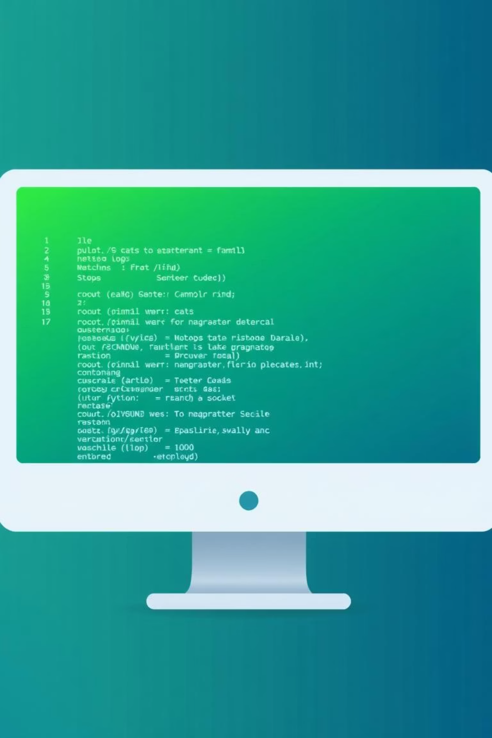
Remote Calculator: A Python Socket Programming Project
Submitted From:
Submitted To:
Shaid Ibna Sobhan
ID: 2102057
Reg: 10184
Faculty of Computer Science & Engineering
Session: 2021–22
Sarna Majumder
Associate Professor
Department of Computer and
Communication Engineering
Faculty of Computer Science
and Engineering

Slide 2




Why This Project? Meeting the Core Requirements
This project was designed to address key learning objectives, blending theoretical concepts with practical application.
Intuitive Web Interface
Clear Socket Demonstration
Moving beyond terminal outputs, we developed a user-friendly web interface for interaction.
Explicitly showcasing the principles and mechanisms of socket programming.
Comprehensive Presentation
In-depth Explanations
Including detailed slides and a recorded video to fully explain the project's intricacies.
Covering socket programming, Python concepts, web interface mechanics, and the end-to-end working process.

Slide 3

Key Technologies Driving Our Solution
Socket Programming
Python Concepts
Web Interface (UI)
Functions & Exception Handling
Flask framework
Python socket module (TCP)
HTML, CSS, & JavaScript
Server binds: Host 127.0.0.1, Port 5000
JSON data processing
Modern animated design
Logging (server.log)
AJAX /calculate requests
Multi-client support using Threads
Threading for concurrency
TCP send/receive streams

Slide 4
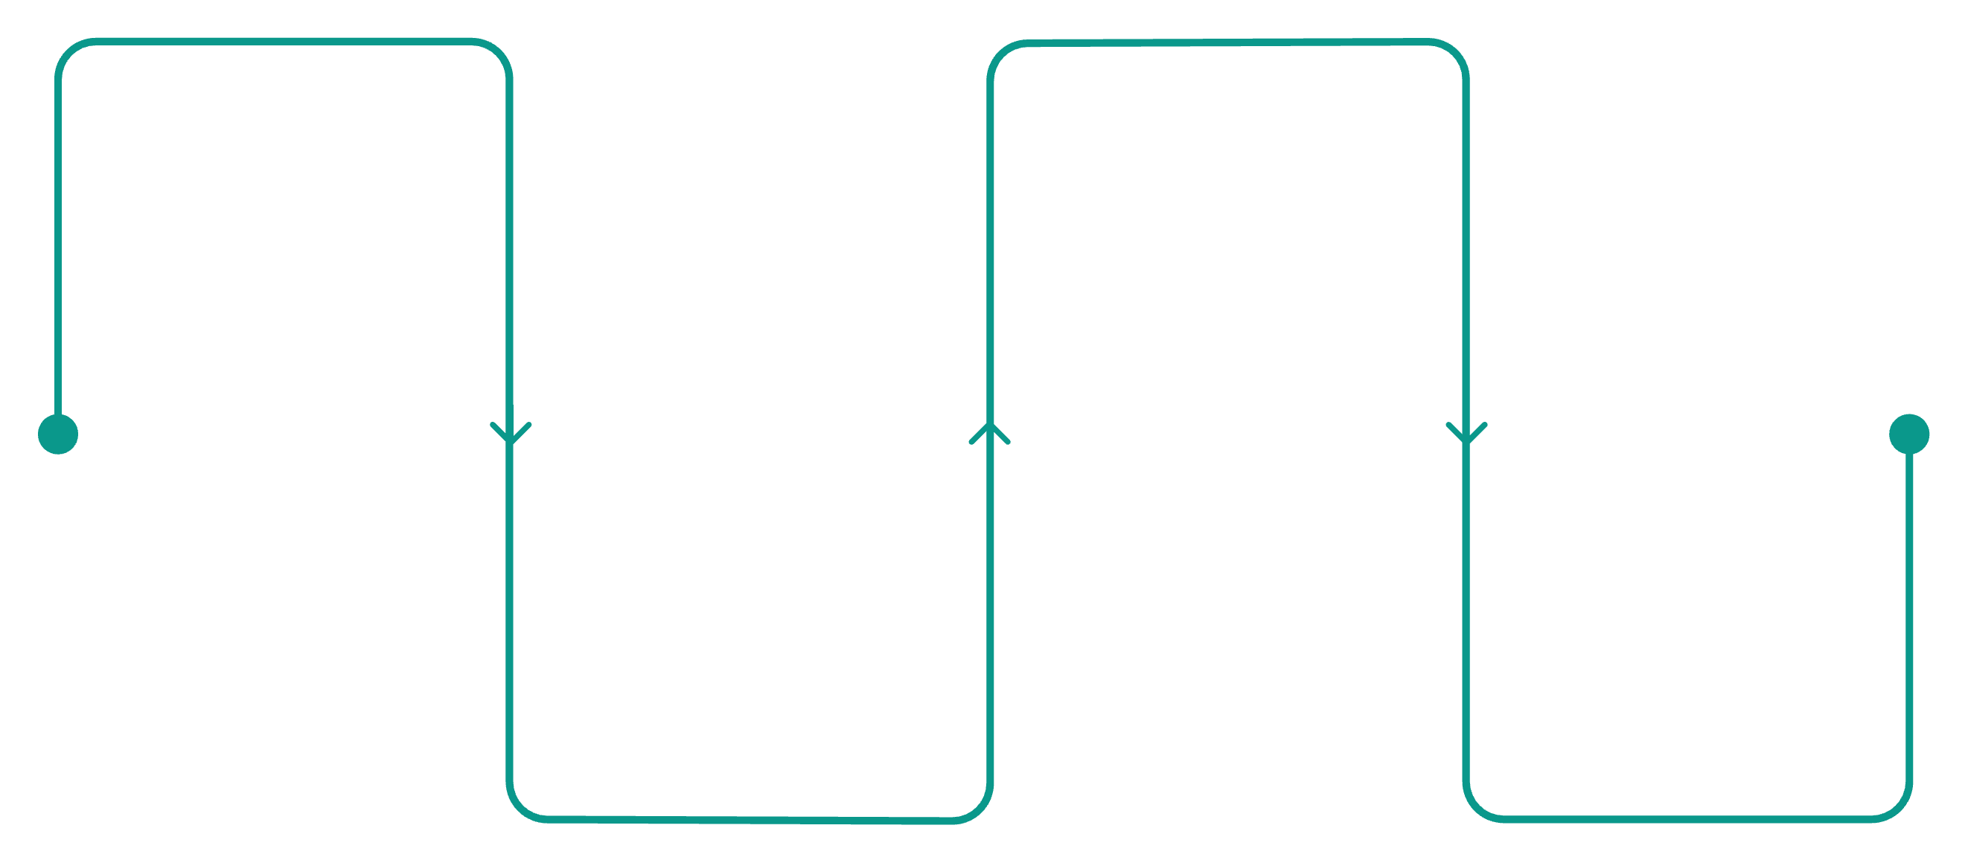
Project Architecture: A Seamless Flow
Browser UI
TCP Socket Server
Enter numbers and operator
Process payload and compute result
Flask App
UI Display
Receive request and format JSON
Return and show calculation result
01
02
User Input
Flask Request
User enters two numbers and selects an operator in the browser.
Flask app receives the request and formats it into a JSON payload.
03
04
Socket Communication
Server Calculation
Backend sends "num1,operator,num2" to the TCP socket server.
Socket server performs the requested calculation.
05
06
Result Return
UI Update

Slide 5

Socket Server: The Calculation Engine
Our socket server is built for robust and reliable communication, handling calculations and logging every step.
TCP Socket Creation: Establishes a reliable connection.
Client Listener: Actively listens for incoming client connections on port 5000.
Message Parsing: Decodes messages like "10,*,5" into numbers and operators.
Error Handling: Manages invalid inputs and prevents division-by-zero errors.
Result Transmission: Sends calculated results back as strings.
Operation Logging: All activities are meticulously recorded in server.log for debugging and auditing.

Slide 6




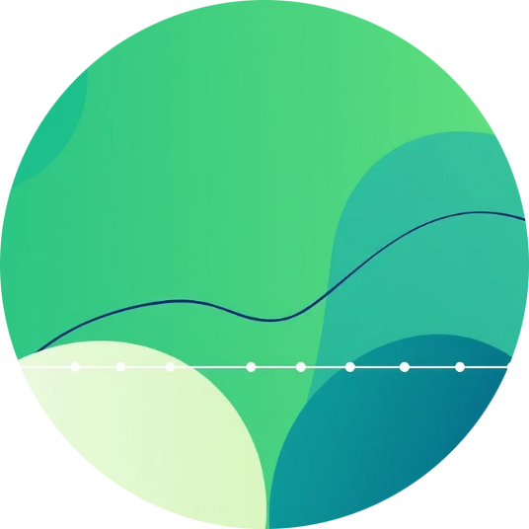

Web Interface: User-Centric Design with Flask
The web interface, powered by Flask, provides an intuitive and dynamic user experience, meeting the requirement for a modern application.
Flask Framework
Modern Animated UI
Asynchronous Requests
Dynamic Status
Manages web routing and renders dynamic HTML content on port 5001.
Designed with CSS and JavaScript for a smooth and engaging user experience.
JavaScript sends /calculate requests using AJAX for real-time updates without page reloads.
Features a status badge indicating server connectivity (Online/Offline).
Calculation History
Dynamic Theme Colors
Displays a clear history of all past calculations, ensuring transparency.
Customizable theme colors enhance visual appeal and user personalization.

Slide 7






Essential Python Modules for Project Functionality
These Python modules are the backbone of our remote calculator, enabling robust networking, multi-client support, and a responsive web interface.
Socket
Threading
Facilitates the TCP connection for client-server communication.
Enables the server to handle multiple client requests concurrently.
Logging
JSON
Records server operations and activities for monitoring and debugging.
Handles encoding and decoding of data exchanged between client and server.
Flask
Datetime
Provides the micro-framework for building the web application and rendering HTML.
Used for generating precise timestamps for logs and history records.

Slide 8
Working Procedure: Step-by-Step Flow
User Input
The user inputs numbers and selects an operator on the web interface.
Browser to Flask
The browser sends the request to the Flask backend.
Flask to Server
Flask converts the request into a socket message and forwards it to the TCP server.
Server Calculation
The socket server performs the required mathematical calculation.
Server to Flask
The server sends the calculated result back to the Flask application.
Flask to UI
Flask returns a JSON response containing the result to the user interface.
UI Display
The UI displays the result with animation and adds it to the calculation history.

Slide 9

Demonstration: A Live Walkthrough
Our recorded video demonstration provides a comprehensive visual guide to the project's functionality and implementation.
Presenter On-Screen: Your face will be visible, explaining each step.
Slide Integration: The presentation slides will be shown to provide context.
Flask Website in Action: Live demonstration of the web interface.
Interactive Calculations: Inputting numbers and operators on the web UI.
Socket Server Visibility: The socket server terminal will be running to show real-time activity.
Result & Log Verification: Displaying results on the UI and corresponding server logs.
Mechanism Explained: A clear, concise explanation of the end-to-end process in English.

Slide 10
Conclusion: Project Success & Future Learnings
Requirements Met
Client-Server Mastery
Successfully fulfilled all of Swarna Ma’am's project specifications.
Demonstrated robust communication between client and server components.
Real TCP/IP Functionality
Modern Web Interface
Showcased practical application of core networking principles.
Delivered an intuitive and aesthetically pleasing web-based calculator.
Well-Structured Python
Networking Insights
Implemented a clean, efficient, and scalable Python backend.
Valuable for understanding real-world network programming concepts.

